Slide 1
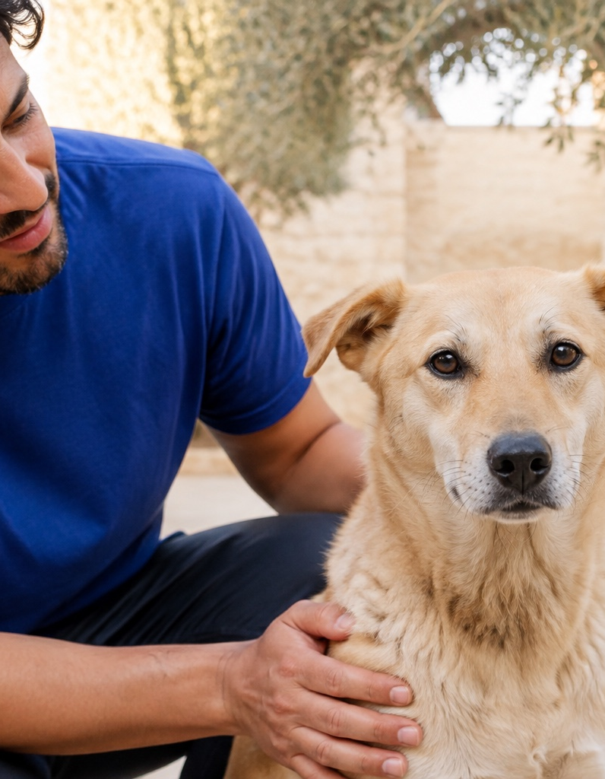
Shelter & Rescue Partners
More support for
the animals
in your care
A free partnership that connects your
organization with people who can help.
No membership fees. No commissions.
Notes:
Barkiva Shelter & Rescue Partners helps organizations receive needed goods, connect with potential adopters and grow a community of supporters. No membership or subscription fee and no commissions charged to the organization. Ordinary purchases and delivery are separate. Images depict illustrative scenes rather than actual partner events.
Content source: User-provided Barkiva charity partnership brief.
Visual: AI-generated rescue-care.jpg

Slide 2
A partnership built
around your daily needs
Your work stays at the centre. Barkiva makes it easier for people to take part.
01
Supplies people can send
Supporters choose from the needs you publish.
02
Pets people can discover
Give every adoptable animal a place to be seen.
03
Supporters who stay connected
Share the care behind every animal’s story.
04
Tools your team can use
Keep pet information and everyday tasks together.
02
Notes:
Four areas of partner value. These are the intended benefits of the programme, not a guarantee of order volumes, adoption outcomes or audience reach.
Content source: User-provided Barkiva charity partnership brief.

Slide 3
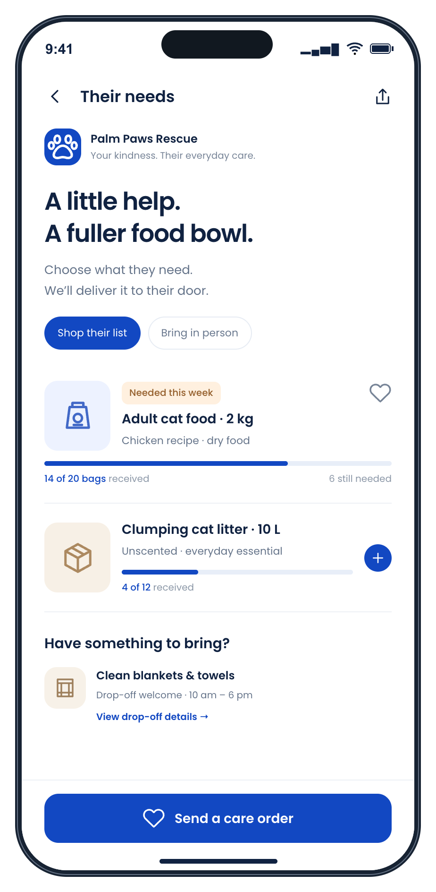
The supplies you need
Help starts with a clear request.
You choose the essentials
Publish the products and quantities
your animals need.
Supporters place charity orders
People can buy those items for your
organization through Barkiva.
More ways to contribute
List needs outside our catalogue so
local supporters can bring them to you.
Illustrative demo
03
Notes:
Organizations select specific products and quantities for charity orders. Supporters can also see needs outside the Barkiva product catalogue and arrange in-kind contributions. Barkiva will encourage this form of support. Confirm delivery coverage and arrangements during onboarding. Demo organization, quantities and activity are fictional.
Content source: User-provided Barkiva charity partnership brief.
Visual: Synthetic app demo-needs.png

Slide 4
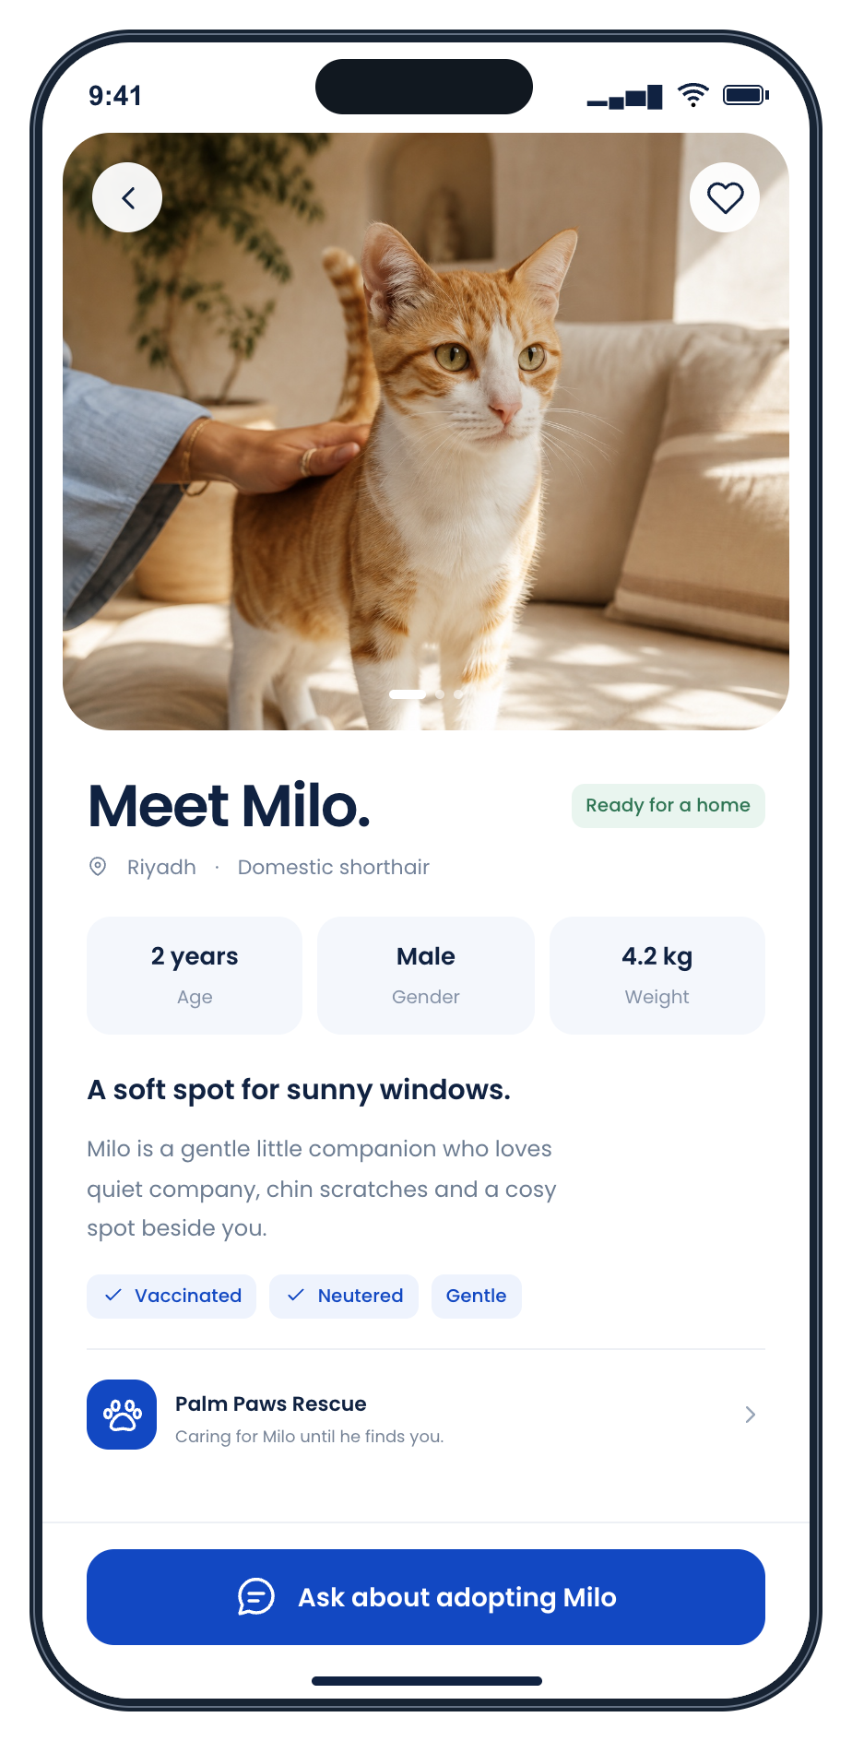
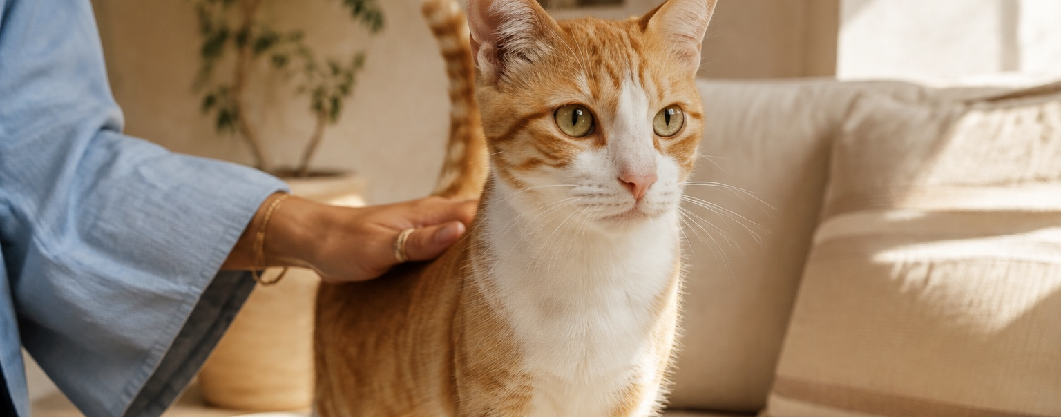
More opportunities
to find a home
A dedicated profile for every adoptable pet.
Barkiva helps bring their stories to potential adopters.
Your team keeps control of screening and adoption approval.
Illustrative demo
04
Notes:
Adoptable animal profiles give potential adopters a way to discover animals and contact the organization. Barkiva will promote the adoption catalogue. The partner organization retains responsibility for screening, suitability assessment and the adoption decision. No adoption-growth claim is made. The pet, organization and screen activity are illustrative.
Content source: User-provided Barkiva charity partnership brief.
Visual: AI-generated adoption-home.jpg
Visual: Synthetic app demo-adoption.png

Slide 5
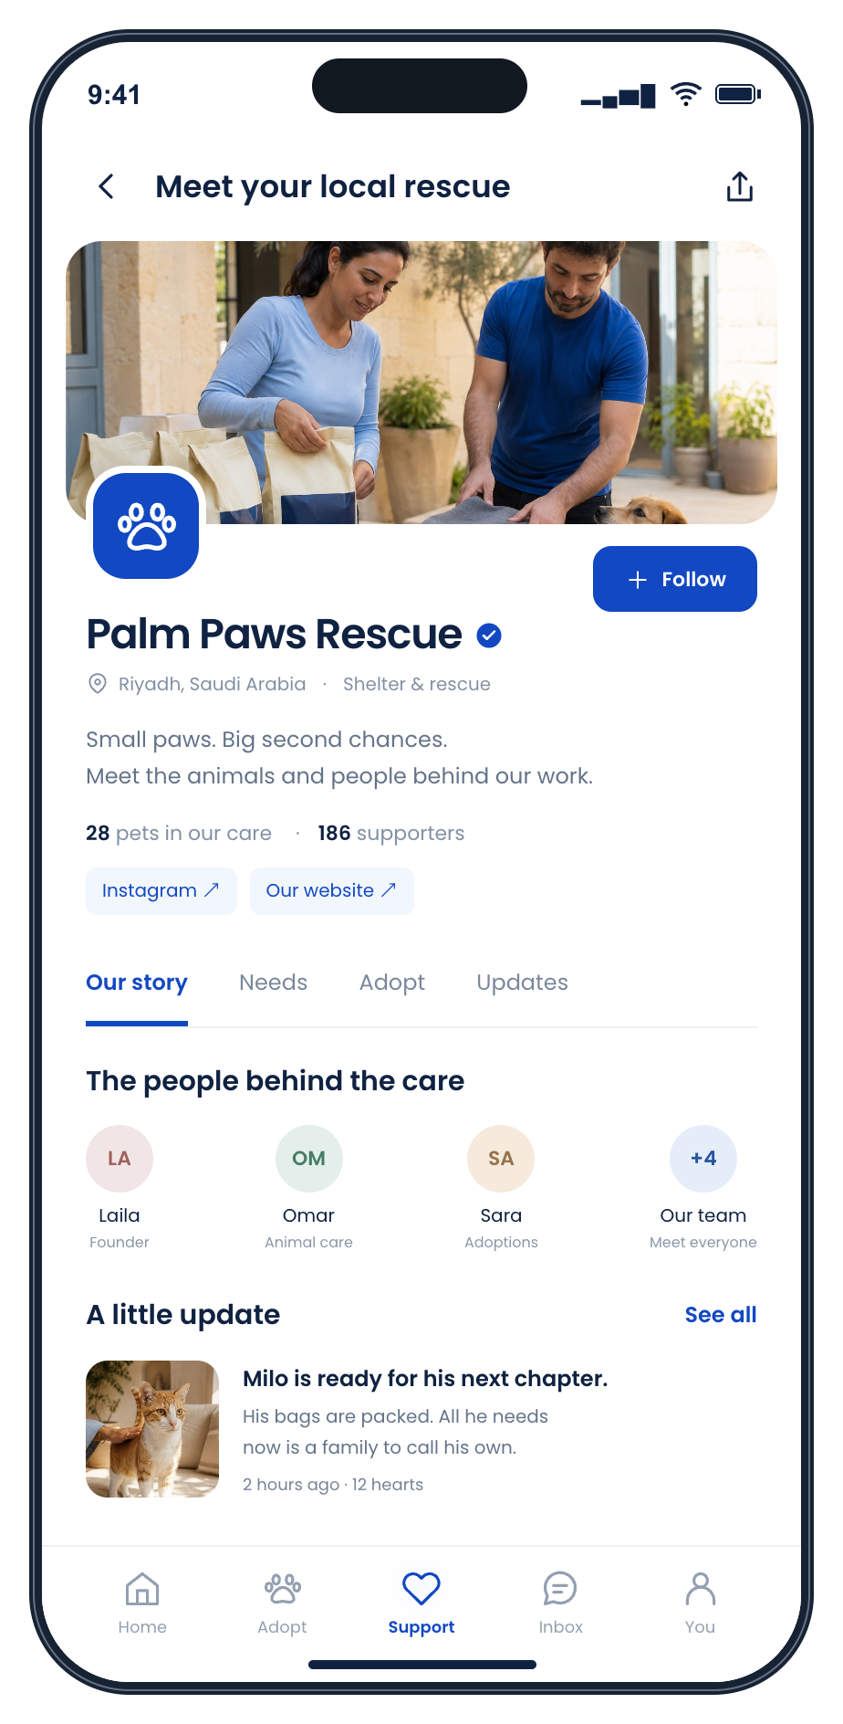
A place for your story
and your supporters
People connect with the care behind the cause.
Introduce your team and the animals you care for.
Share news, milestones and urgent needs.
Let people follow your work and return to help.
Your social channels stay part of the story.
Illustrative demo
05
Notes:
A public organization page includes its story, team, updates, social links and ways to support. Users can follow organizations. Barkiva will share social channels and feature partners through its own promotion. Any follower or activity counts in the demo are fictional.
Content source: User-provided Barkiva charity partnership brief.
Visual: Synthetic app demo-profile.png

Slide 6
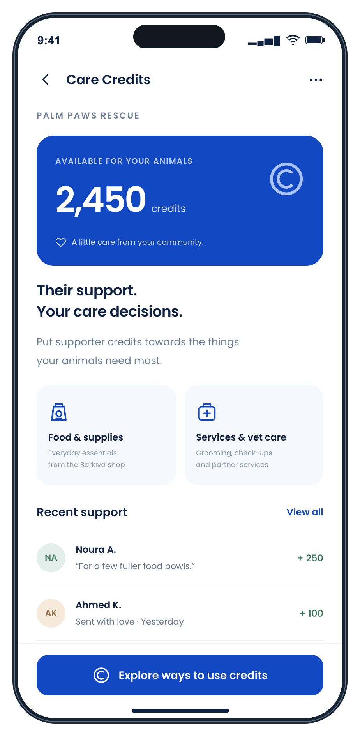
More affordable care
Partner discounts
Special prices for charity organizations
help make everyday essentials more accessible.
Barkiva Care Credits
Planned
Supporters send credits. Your team chooses
the products, services or veterinary visits
that will help most.
Illustrative demo
06
Notes:
Partner discounts are part of the proposed commercial offer. Care Credits are planned: users send credits that organizations may spend on eligible products, services and veterinary visits. Credit purchasing value, eligible providers, redemption rules and availability need confirmation before launch. Demo balances and transactions are fictional and do not establish a cash or currency value.
Content source: User-provided Barkiva charity partnership brief.
Visual: Synthetic app demo-credits.png

Slide 7
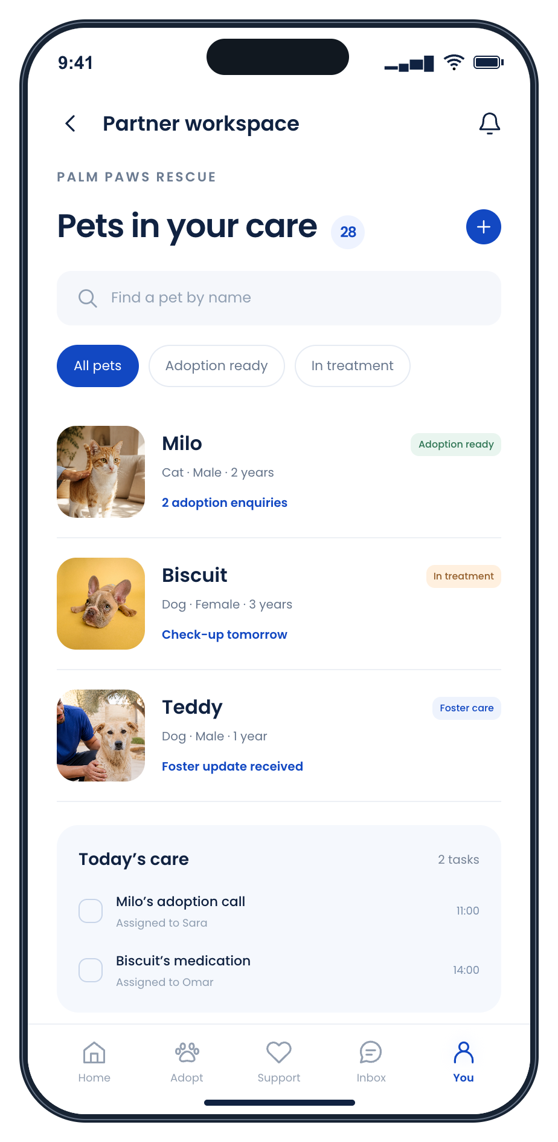
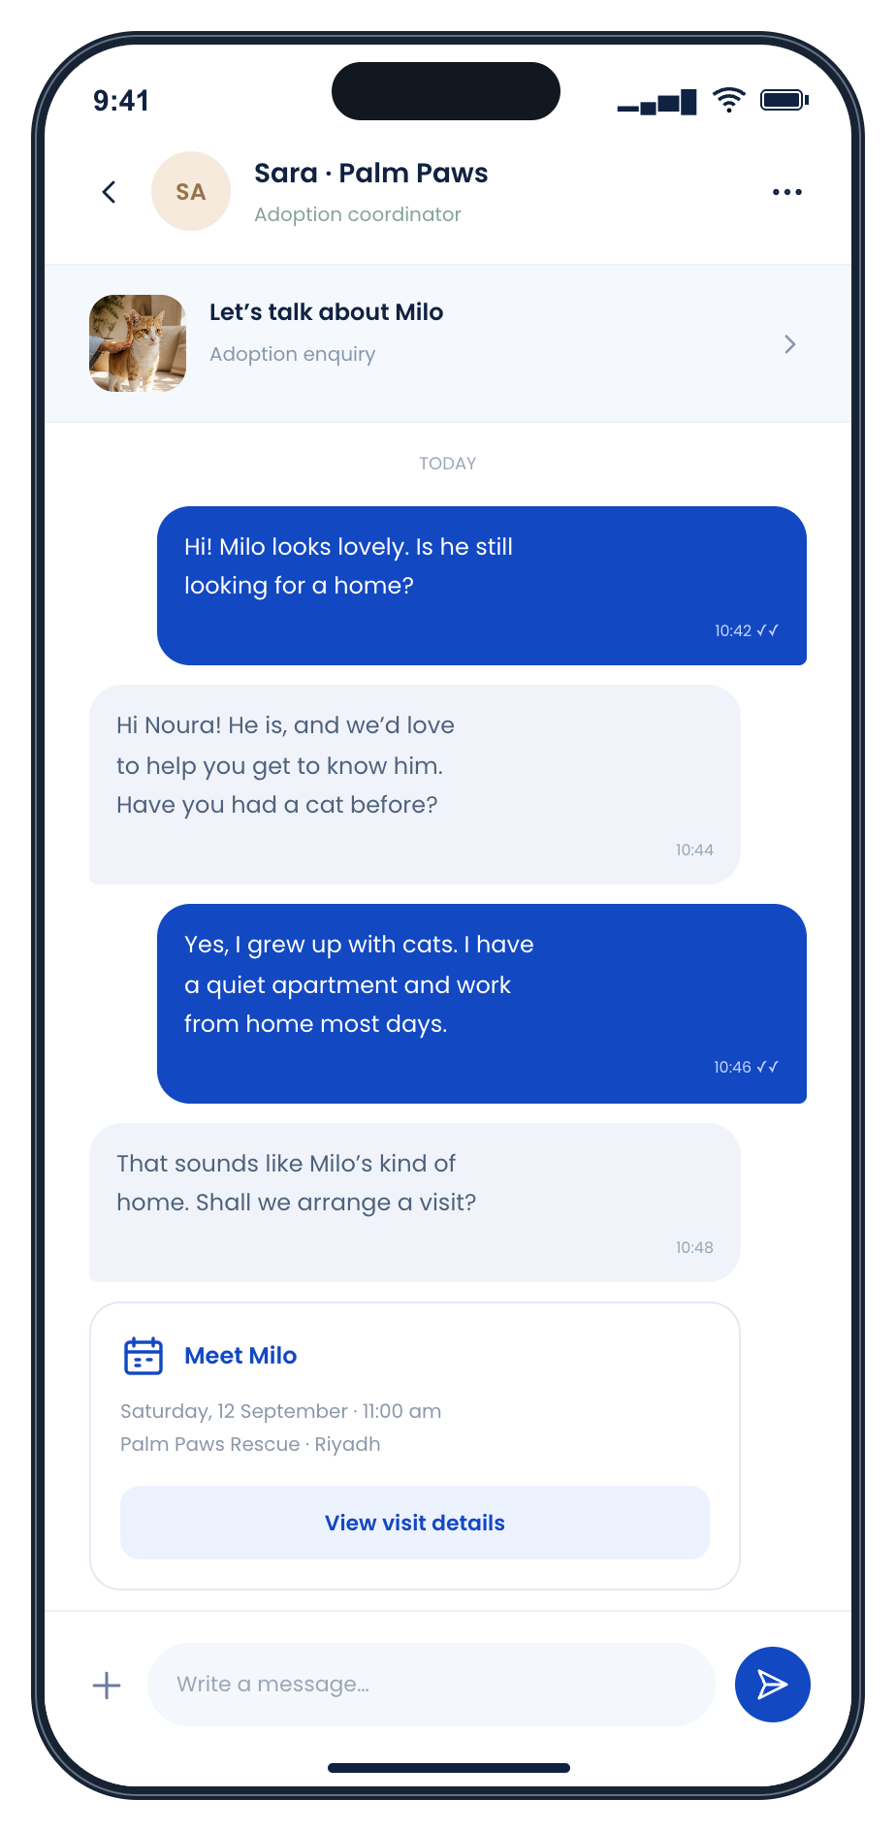
Tools for the team
behind every rescue
Pet management
Keep pet profiles and care information
in one place as your animals move
through their journey.
Conversations in the app
Planned chat for adoption enquiries
and coordination with supporters.
Illustrative demos. Chat planned.
07
Notes:
Pet management supports the organization’s animal records. In-app chat is planned and is shown as a concept for communicating with potential adopters and supporters. The screens illustrate the product direction and are not a claim that this exact interface is currently available.
Content source: User-provided Barkiva charity partnership brief.
Visual: Synthetic app demo-management.png
Visual: Synthetic app demo-chat.png

Slide 8
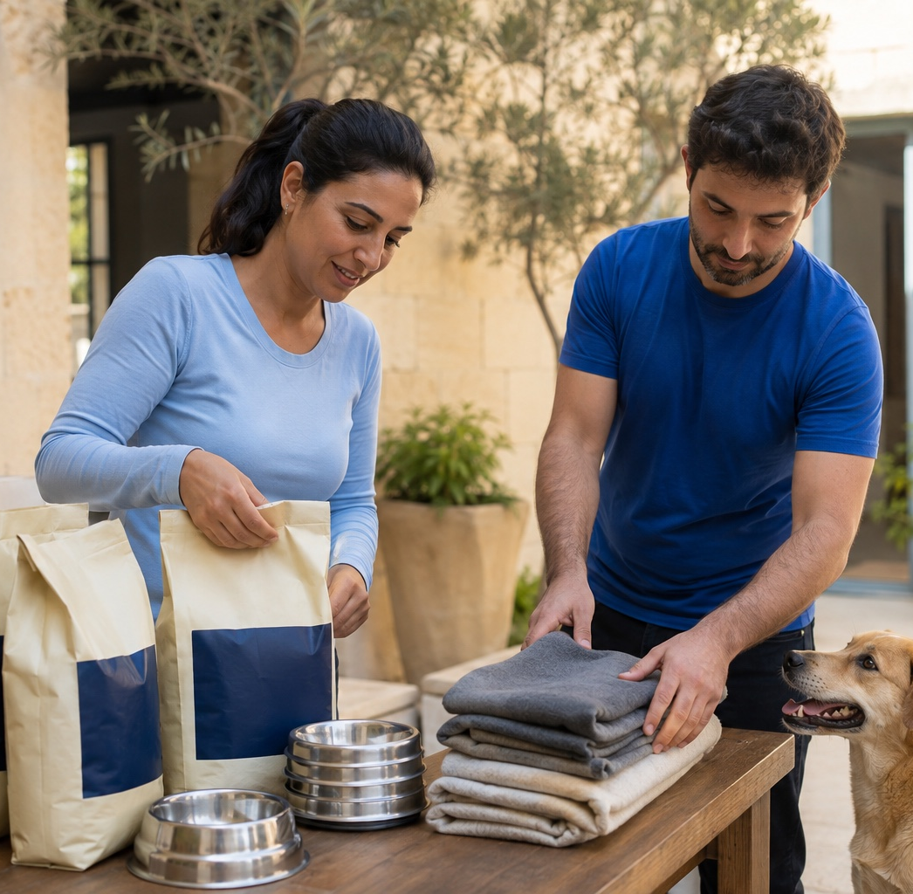
More people
behind your cause
Shared campaigns
Stories that introduce your animals
and explain what they need.
Events with a purpose
Adoption days and focused
supply drives, planned together.
Each campaign starts with a clear request.
Notes:
Barkiva and partners can plan adoption events, supply drives and marketing campaigns. Specific channels, timing and scope should be agreed with each partner. The scene is illustrative and does not represent a past Barkiva event.
Content source: User-provided Barkiva charity partnership brief.
Visual: AI-generated community-care.jpg

Slide 9
Free to join
A partnership for your mission
No membership fee
No subscription fee
No commissions charged to your organization
Ordinary product, service and delivery charges are separate.
09
Notes:
As specified in the partner brief, Barkiva does not charge the organization membership fees, subscription fees or commissions for participation. This does not make purchased goods, booked services or delivery free. Confirm applicable prices and delivery terms during onboarding.
Content source: User-provided Barkiva charity partnership brief.

Slide 10
A simple, shared commitment
Barkiva provides
Your organization contributes
Help setting up your profile and needs
Promotion of your animals and stories
Partner materials with your QR code
Support for agreed launch activities
Current pet profiles and needs
Responses to adoption enquiries
Recommendations to your community
Visible Barkiva partner materials
Your QR code leads people to your animals, your needs and your story.
10
Notes:
Partner ask: keep adoptable animal profiles and needs current, respond to enquiries, and recommend Barkiva to adopters and supporters using supplied cards, QR materials or branded products. Barkiva offers onboarding assistance and agreed promotional support. Partners retain their own identity and adoption process.
Content source: User-provided Barkiva charity partnership brief.

Slide 11
Getting started
We help you prepare the first profile, pets and needs.
01
Meet your team
Agree priorities, delivery arrangements
and a main contact.
02
Set up your presence
Prepare your story, adoptable pets
and first needs.
03
Launch together
Share your QR materials and launch
a focused campaign.
04
Review what helped
Review support and adoption enquiries.
Hear feedback from your team.
An initial pilot gives both teams a clear starting point.
11
Notes:
Suggested onboarding model: meet, set up, launch and review. A pilot period can be agreed with the organization. Review tangible contributions, relevant adoption enquiries and time spent by the team. No results or set launch timeline are promised in this deck.
Content source: User-provided Barkiva charity partnership brief.

Slide 12
More support for
the animals in your care
Barkiva Shelter & Rescue Partners
A free partnership. A shared commitment to better care.
wecare@barkiva.com
www.barkiva.com/en/shelter-partners
Notes:
Contact email follows the existing shelter and rescue partnership inquiry CTA in web/src/modules/community/templates/community-template.tsx. Canonical domain follows web/src/lib/env.ts. Partnership page URL is the new page created alongside this deck. All demo organizations, pets, balances, activity and photography in this presentation are illustrative. Care Credits and in-app chat are planned.
Content source: User-provided Barkiva charity partnership brief.

