Slide 1
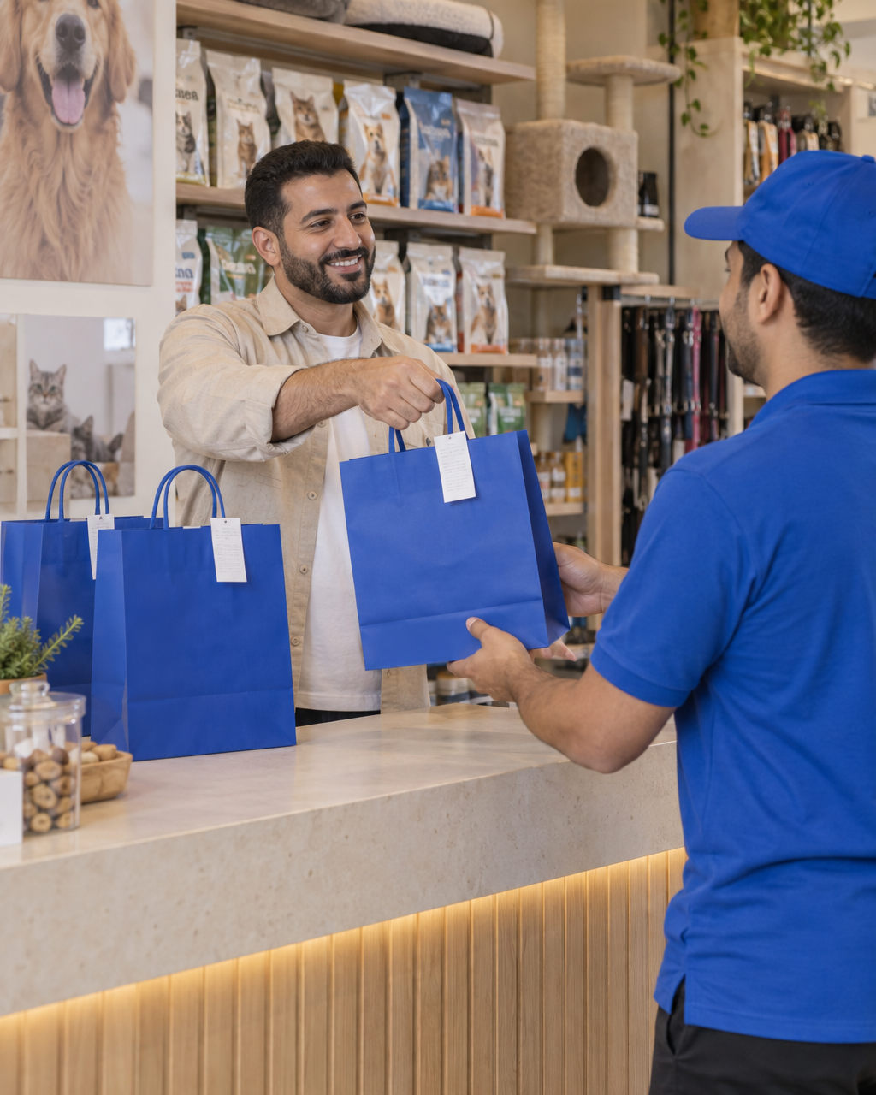
Q-commerce Partners
Your store.
More customers.
Delivery handled.
A new sales channel for your pet store,
with delivery through Barkiva.
Pet retail partnerships
Notes:
Proposed Barkiva pet retail partnership. Delivery uses agreed collection windows. Images show illustrative scenes, not existing partner events.
Source: Barkiva partnership model provided by the project owner. Screens and example figures are illustrative.

Slide 2
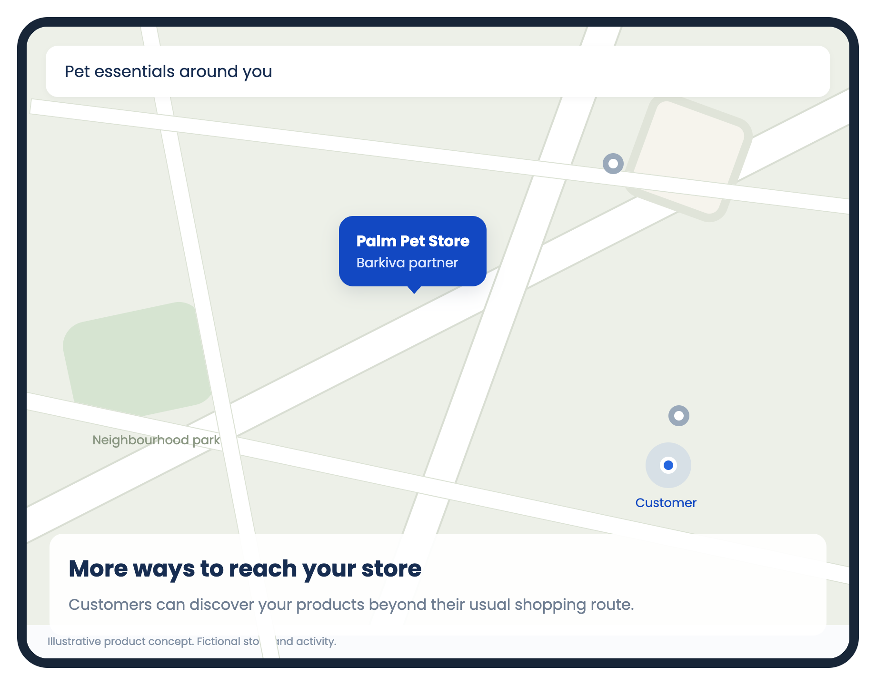
Beyond your
usual catchment
New ways to discover your store
Reach pet owners who may not pass
your shop on their everyday route.
Products within delivery reach
Barkiva connects nearby demand
with your available stock.
Illustrative product concept
02
Notes:
Map is schematic, not a real service area. Coverage and delivery windows are agreed before launch. Incremental customer reach is a hypothesis to measure in the pilot, not guaranteed demand.
Source: Barkiva partnership model provided by the project owner. Screens and example figures are illustrative.

Slide 3
More orders from
the store you already run
Your store contributes
Barkiva contributes
Available stock and product knowledge
A team that picks and packs orders
Agreed prices with room for your margin
Customer discovery and order flow
The partner app and delivery operation
Promotion within the pet community
The goal: worthwhile additional business for both teams.
No separate storefront or courier team needed for these orders.
03
Notes:
Store labour, inventory and handling still have costs. Profitability depends on agreed prices, incremental order volume and execution costs. This is not a guarantee of profit.
Source: Barkiva partnership model provided by the project owner. Screens and example figures are illustrative.

Slide 4
The order journey
01
02
03
Receive & decide
Pick the products
Pack & print
The app receives the order.
Your team accepts or declines.
Check the items and quantities.
Prepare for the agreed pickup.
Use bags supplied by Barkiva.
Attach the printed order slip.
04
05
06
Scheduled collection
Customer delivery
Settlement & insight
Our courier collects the orders
ready for that pickup window.
Barkiva handles delivery
to the customer.
Receive the agreed payout.
Review orders and performance.
04
Notes:
Operational sequence supplied by the user. The receipt or order slip is an operational attachment. Tax invoicing requirements and the issuer must be determined during onboarding.
Source: Barkiva partnership model provided by the project owner. Screens and example figures are illustrative.

Slide 5
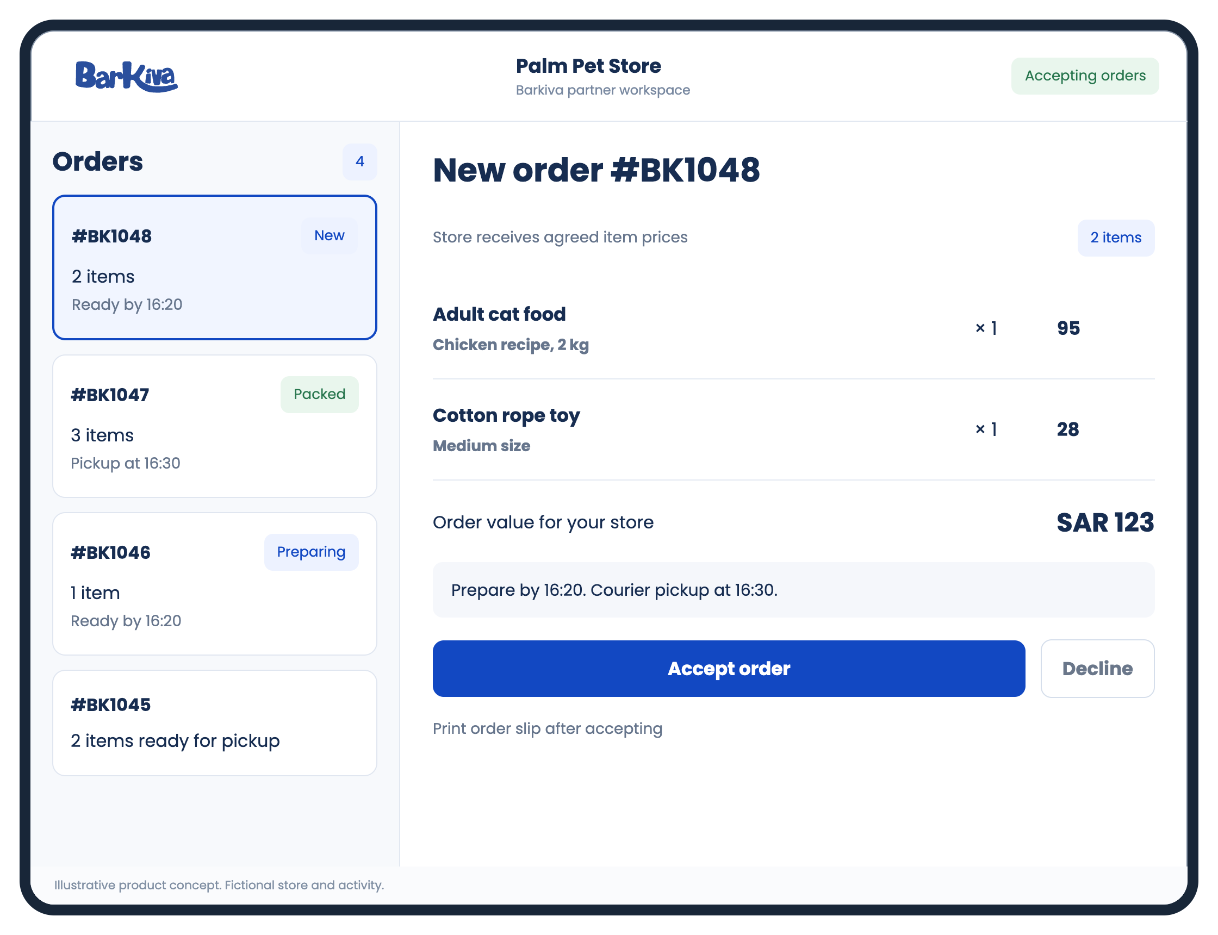
One app. Your team in control.
A terminal for your store
Use the POS terminal we provide,
or your compatible device
with our app.
Clear order decisions
See products and preparation time.
Accept or decline each order.
Proposed controls: stock availability,
opening hours and an order pause.
05
Notes:
Barkiva supplies a POS terminal or supports compatible partner hardware with its app. Device costs, ownership, compatibility and printer setup are agreed in the contract. Stock controls, capacity limits, pause controls and integrations are proposed product additions, not verified shipping capabilities.
Source: Barkiva partnership model provided by the project owner. Screens and example figures are illustrative.

Slide 6
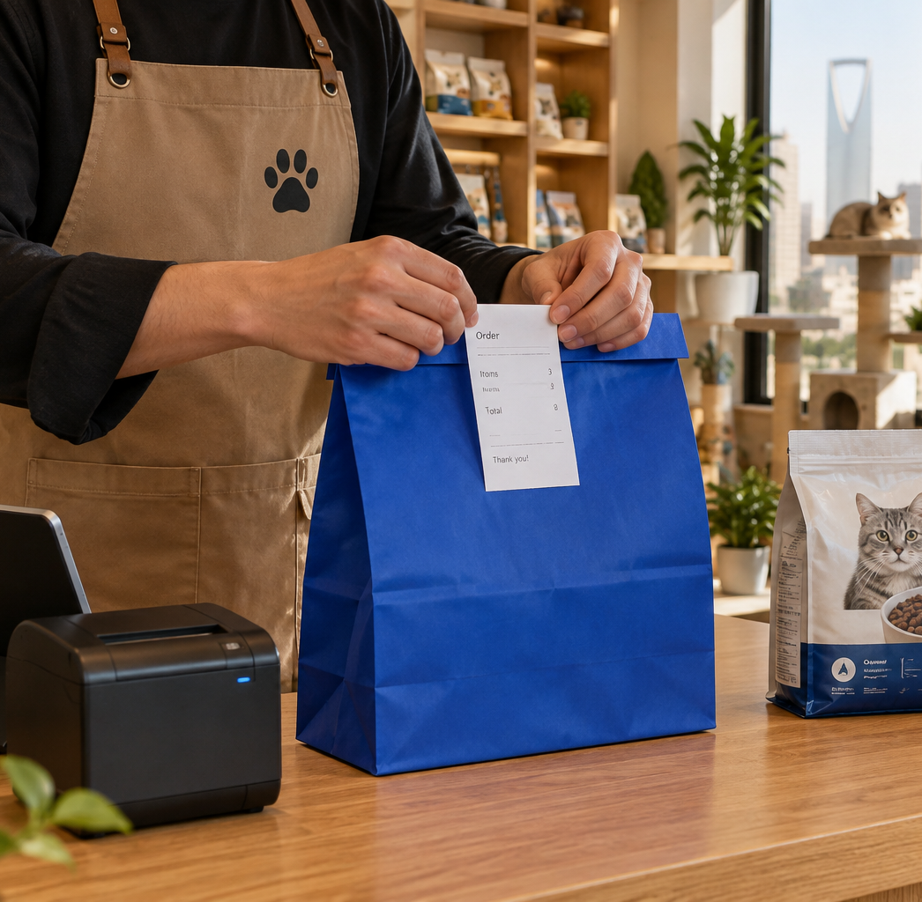
Ready for
easy handover
Barkiva supplies the bags
Your team packs the products
and attaches the order slip
printed through our app.
Every order stays identifiable
Keep each order together
with its own order ID.
Notes:
Illustrative packing scene. Packaging supply is part of the proposed operating model. Agree packaging quantities, replenishment and any costs before launch.
Source: Barkiva partnership model provided by the project owner. Screens and example figures are illustrative.

Slide 7
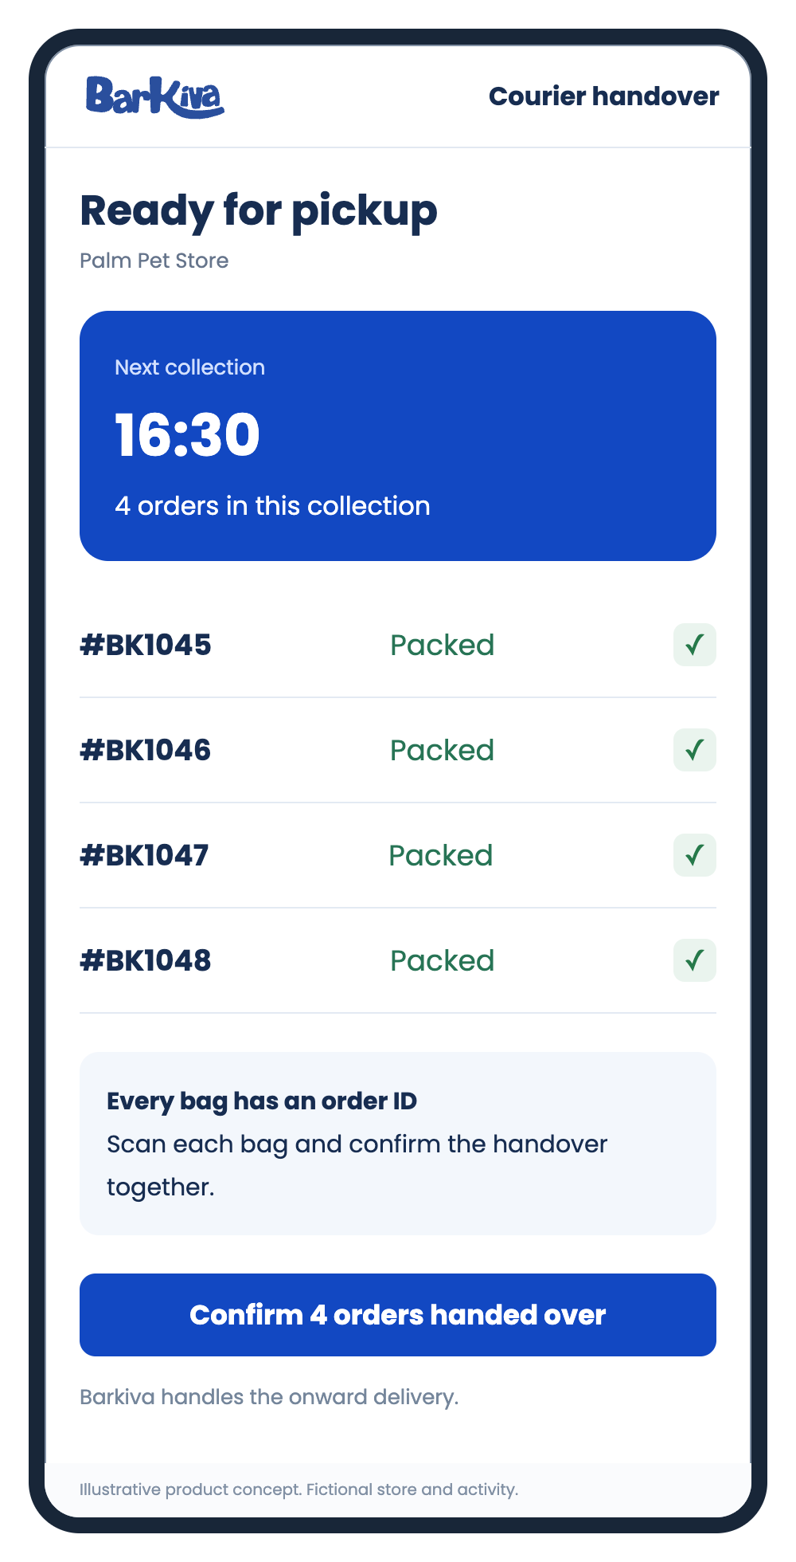
Delivery handled by Barkiva
One scheduled collection
Our courier arrives at the agreed time
and collects the orders prepared
for that collection window.
A clear record of the handover
Proposed bag scanning confirms what
the courier receives. Delivery status
keeps your team informed.
07
Notes:
Pickup windows, preparation deadlines and delivery coverage must be agreed. Bag scanning and handover confirmation are proposed workflow safeguards. Define support, missed pickups, returns, cancellations and damaged goods responsibilities in the agreement.
Source: Barkiva partnership model provided by the project owner. Screens and example figures are illustrative.

Slide 8
A transparent pricing model
Your agreed price + Barkiva markup. Delivery charged at cost.
Illustrative order in SAR
What the store retains
Shelf price for reference | 100
Agreed amount for the store | 95
Barkiva product markup | 10
Customer product price | 105
Delivery charge = delivery cost | 12
Customer total before tax | 117
95 − 70 − 3 = 22
Agreed price less product cost
and additional handling cost.
SAR 22 contribution
Before fixed overheads, taxes
and returns. Barkiva’s markup
also covers its own costs.
Illustrative amounts, not agreed rates. Prices, taxes, adjustments and payout timing follow the contract.
08
Notes:
User-provided proposed model: store agrees a product price slightly below its shelf price. Barkiva adds its own product markup. Customer delivery charge equals delivery cost. Example only, all SAR and before tax: shelf 100, partner 95, markup 10, product 105, delivery 12, checkout 117. Partner contribution = 95 - product cost 70 - incremental handling 3 = 22, before overheads, tax and returns. Barkiva markup is revenue before its costs, not net profit. Additional order volume is not guaranteed. Commercial terms remain negotiable.
Source: Barkiva partnership model provided by the project owner. Screens and example figures are illustrative.

Slide 9
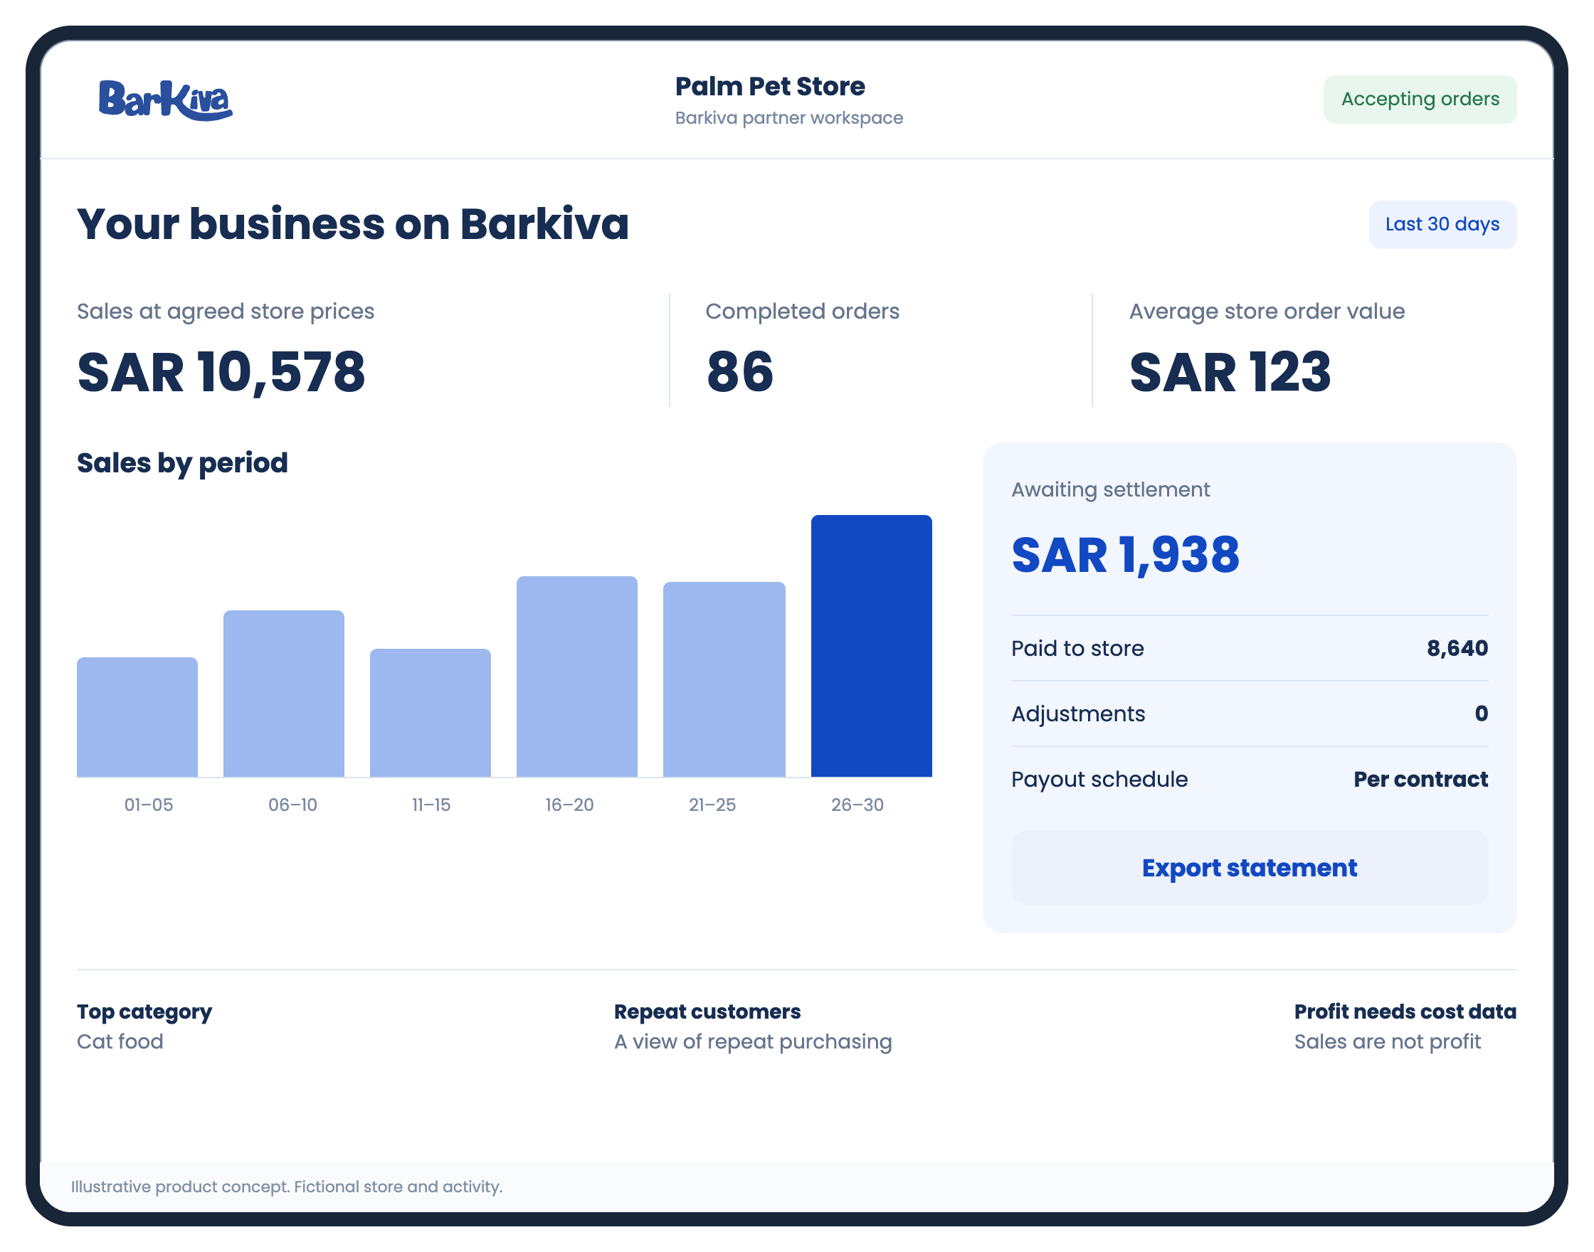
A clear view of your business
Orders, agreed-price sales and settlement in one place.
Understand the payout
Track completed orders,
paid amounts and the
next settlement.
Plan the next order
Use product demand and
repeat purchases to guide
stock and promotions.
09
Notes:
Fictional analytics: 86 completed orders, average agreed-price order 123 SAR, sales 10578 SAR. Paid 8640 plus pending 1938 =10578. Six chart periods sum to 10578. Demo excludes tax and adjustments. A dashboard can report sales and settlement, but net profit requires cost data. Export, repeat-customer and detailed analytics are proposed tools.
Source: Barkiva partnership model provided by the project owner. Screens and example figures are illustrative.

Slide 10
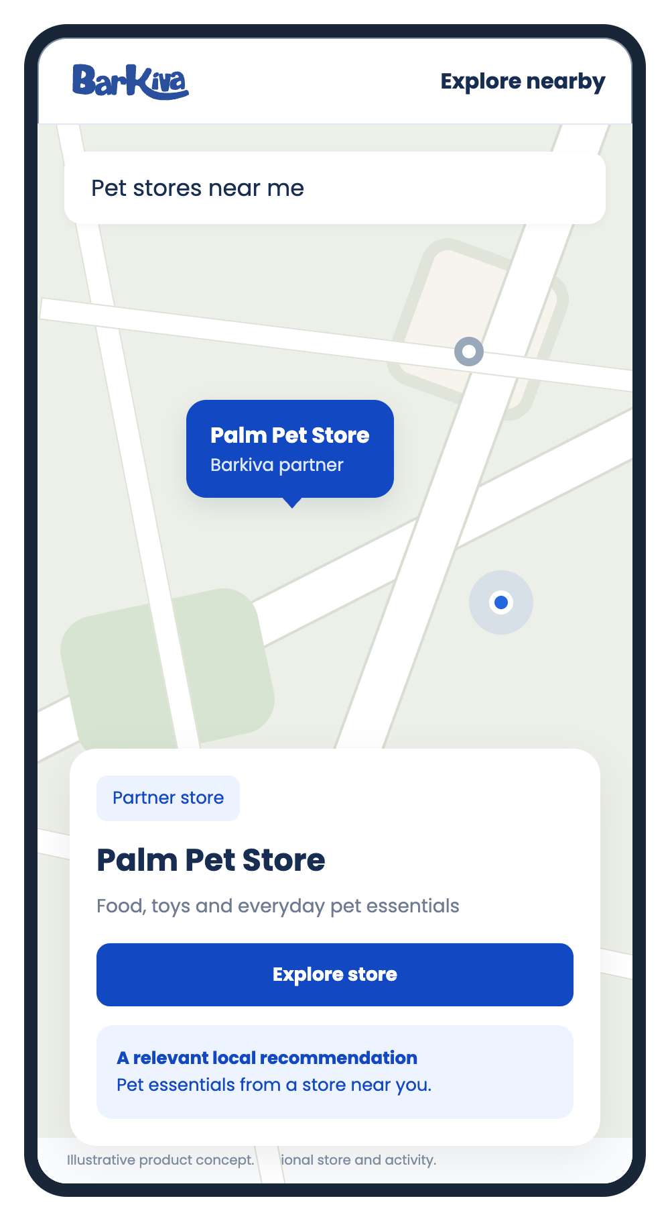
A more visible local partner
A recognisable place on the map
A prominent partner marker and store profile
help customers recognise your business.
Recommendations that fit the location
Planned local recommendations can introduce
your products to people nearby. Follow and
reorder tools can support repeat purchases.
Proposed discovery tools. Reach depends on coverage and relevance.
10
Notes:
Enhanced partner markers and nearby marketing are proposed by the user. Follow/reorder tools are proposed additions. Location recommendations should respect customer permissions and preferences. Map schematic and fictional store. Do not promise exclusive territory or guaranteed placement reach.
Source: Barkiva partnership model provided by the project owner. Screens and example figures are illustrative.

Slide 11

Shared growth.
Shared community.
Campaigns built together
Joint offers, social mentions
and seasonal campaigns give
your store more ways to take part.
Support that reaches animals
Charity orders and supply drives
connect your store with local
shelters and their supporters.
Notes:
Joint promotions, social mentions and charity collaboration are proposed. Each campaign requires agreement on its budget, discount funding and participation. Participation does not imply mandatory donations or unspecified discounts. Photo is illustrative.
Source: Barkiva partnership model provided by the project owner. Screens and example figures are illustrative.

Slide 12
A clear start, measured together
01
Agree the partnership
Product prices, payouts, pickup windows
and responsibilities.
02
Prepare the store
Set up the catalogue, POS and printer.
Training and a named support contact.
03
Launch a focused pilot
Start with an agreed range and delivery area.
04
Review the business case
Assess contribution, handling time
and repeat demand.
Let’s explore a partnership for your store.
wecare@barkiva.com
Notes:
Suggested pilot review metrics: completed incremental orders, contribution after variable costs, handling time, stock-related rejection, on-time handover and repeat purchases. Agree a support contact and rules for unavailable items, cancellations, returns, damage and delayed collection before launch. No rates, free hardware terms or payout dates are promised. Contact follows the existing Barkiva partnership email.
Source: Barkiva partnership model provided by the project owner. Screens and example figures are illustrative.

